Slide 1
Munich Re - Coupa Supplier Guide
January 2021 Central Procurement

Slide 2
Agenda
Coupa Supplier Portal - Supplier Training Guide
1
Introduction to Coupa
3
2
Registration
13
3
Manage your Account
30
4
Purchase Orders
43
5
Invoices - Coupa Supplier Portal CSP
48
6
Credit Notes - Coupa Supplier Portal CSP
65
7
Support
69

Slide 3
Introduction to Coupa
1

Slide 4
Introduction to Coupa
What is Coupa?
Munich Re has selected Coupa as the technology platform to streamline the procure-to-pay processes and enable electronic Purchase Order and Invoice transmission.
Coupa is a leading e-Procurement platform, connecting buyers with their suppliers.
Coupa is an internet-based solution capable of accommodating a variety of different systems. (plug and play)
The Coupa Supplier Portal (CSP) will be used by Munich Re to request products and services, create and communicate Purchase Orders, as well as receiving and paying Invoices.
PO, PO Change
Suppliers
Catalogs, Workflow
PO Acknowledgement
3-way Match
Invoice

Slide 5
Introduction to Coupa
How will you benefit?
By working with Munich Re electronically, you will increase your order-taking efficiency, reduce mistakes and delays fulfilling orders, be able to maintain a better presence with Munich Re.
Reduced Manual Handling
Convenient
Greater control over the order processing.
Ability for all suppliers to create electronic invoices improving efficiency and quality of transactions.
Better communication and visibility with Munich Re.
Improved directed buy for users to accelerate spend with our preferred suppliers.
Improved quality & faster invoice-to-pay process with convenient visibility into the status of your invoices.
No installation of hardware or software required.
Web applications that are quick to set up and easy to use.
Reduced manual paper transaction processing
Best of all, it’s free of charge! There is no cost for you to transact through this application.
Better Cash Flow
Reduced Supplier Costs
Accurate & Efficient

Slide 6
Introduction to Coupa
How will you benefit?
In a nutshell, Coupa:
Enables Suppliers to create legally compliant electronic invoices in their country of origin
Coupa reviews and implements invoice under all applicable laws, going far beyond just tax related requirements.
Uses best effort to deliver high quality data, taking structured data directly from the source instead of utilizing other sources (e.g. paper scanning)
Guaranteed delivery of invoices
Better visibility and increased straight-through processing
Fewer exceptions, fewer calls/email exchanges, a chance to get paid on time
Easier audits, better transparency
Coupa invoice channels are clearly defined so everyone knows his duties
One of the main question asked by suppliers is
“When will I get paid?”
What follows is a long exchange between you and Munich Re
Which invoice are you talking about?
When did you send it?
How did you send it?
I haven´t received it!
I found it but there is information missing from it, so I can´t pay it!
Not just frustrating – Expensive for both parties!!
With
these conversations will be a thing of the past

Slide 7
Introduction to Coupa
How will you benefit?
You Are The Most Important Part Of This Project !
Supplier participation is key to project success
You will get support with requirements deriving from electronic processing if needed
Coupa is lifting suppliers globally to new levels of legal and commercial compliance
Coupa can enable you by:
Pushing legally required data fields per country (Tax and Commercial Laws)
Applying population rules to ensure presence of data (Line descriptions, VAT IDs etc.)
Applying validation rules to check accuracy of data where possible
Allowing you to immediately correct invoice data in case of errors
Using state of the art digital signatures according to locally applicable laws
Coupa saves all legal and compliant electronic invoices in the Coupa Supplier Portal, where suppliers can access and download them

Slide 8
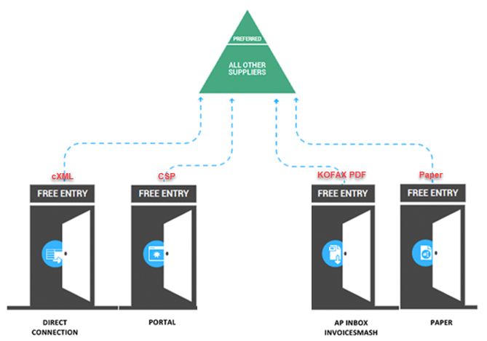
Introduction to Coupa Coupa: 4 doors to send invoices to Munich Re

Slide 9
Introduction to Coupa
Invoice Transmission Methods
Transmission method
PDF Email
Supplier creates from his invoice a PDF-file.
Supplier submits the PDF-file via Email to a specific Munich Re Mailbox:
Munich Re receives invoice in Coupa
MunichRe-invoices@mail.coupa.readsoftonline.com
Supplier receives a Munich Re purchase order
Supplier want to invoice
Coupa Supplier
Portal (CSP)
Supplier logs
into CSP
Supplier flips PO into invoice
Munich Re receives
invoice in Coupa
cXML
(machine to machine
integration)
Munich Re receives invoice in Coupa

Slide 10
Introduction to Coupa
Supplier Information – Basic understanding
After reviewing this documentation you will have gained a basic understanding of the Coupa system and it’s introduction at Munich Re.
You will be able to:
Register and setup your profile on the Coupa Supplier Portal (CSP).
Perform basic navigation of the Coupa Supplier Portal (CSP).
View/manage purchase orders through the Coupa Supplier Portal (CSP).
Create invoices/credit notes within the Coupa Supplier Portal (CSP) via the “PO flip” functionality.

Slide 11
Introduction to Coupa
What is changing?
Munich Re is in the process of rolling out Coupa globally. Go Live for Germany was May 15th for POs (Invoices at July 6th). We expect to go live with the new system in the US and UK starting in 2021.
Purchase orders sent from Coupa will have a naming convention of a 7-digits number #XXXXXXX (e.g. 0000307) and will require invoice submission through Coupa via the new electronic invoicing procedures. (The current process has a naming convention of 45XXXXXXXX.)
Any purchase orders received that do not contain the #XXXXXXX naming convention should be handled using the current processes.
Your local contact may still send POs to you manually for the foreseeable future, so please confirm all orders with the requester.
Munich Re is requiring electronic invoicing through Coupa, allowing suppliers to use the Coupa Supplier Portal to simplify & streamline the receipt and acknowledgement of purchase orders and the submission of invoices to Munich Re.

Slide 12
Introduction to Coupa
Coupa Compliant Invoicing
Munich Re will use Coupa’s Compliance-as-a-Service module.
As a supplier, you authorize Coupa to generate an invoice on your behalf based on invoice data you have provided. Coupa will send the PDF invoice to you and to Munich Re.
Coupa generated PDF invoice is the only legal invoice for you and Munich Re. You are required to use the Coupa Invoice to file your VAT declaration.
Subsequently, you explicitly agree to refrain from creating and sending your own invoices for these transactions outside of the Coupa platform or to attach any invoice images to the Coupa transaction.

Slide 13
Registration
2

Slide 14
Registration and Setup
Transactions in Coupa Via CSP
With the help of Coupa, Suppliers will be able to quickly receive and acknowledge POs, and create electronic invoices via online platform.
As a Supplier, you will have the ability to :
Manage your company information
Configure your PO and invoice transmission preferences
Create an online catalog
View all of your purchase orders
Create and manage invoices to Munich Re

Slide 15
Registration and Setup
Connection to Munich Re via Coupa
It is imperative that all suppliers connect to the Coupa platform to transact with Munich Re successfully. Each of the below steps must happen before a supplier can properly interact with Munich Re:
Update Contact Details
Accept Invitation from CSP
Update Account
Transact with Munich Re
Notify Supplier Enablement Team of key contacts
Identify Primary contact
Will come from “Coupa Supplier Portal”
Will be delivered to the primary contact
May land in junk mail
Must be a unique email address
Add users
Update profile
Merge accounts
Update Banking details
Receive POs
Acknowledge POs
View PO details
Create Invoices

Slide 16
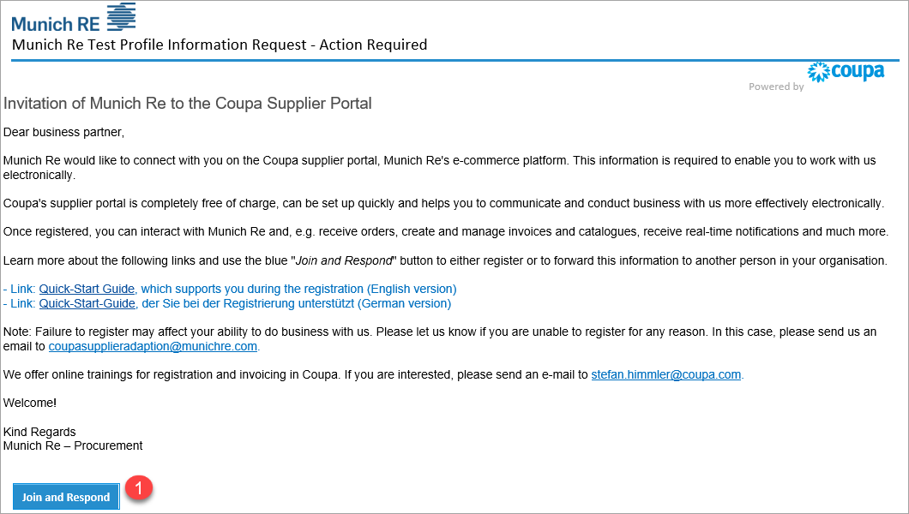
Registration
How to join Coupa Supplier Portal (CSP)
You will receive an invitation email to the Coupa Supplier Portal from Munich Re with the subject line: “Action Required from Munich Re - Click Below to Join Coupa”.
If you did not receive an invitation email, please send a request to: Procurement@munichre.com.
Please alert your team to keep a look-out for this invitation and act upon it when it is received. Be sure to click only on the direct link „Join and Respond“ (1) at the bottom of the email invitation for CSP account registration. This will take you to the registration screens where you will complete your profile.
If you’re not the right person or you’d like someone else to register instead, you can later in the process forward the invitation.

Slide 17
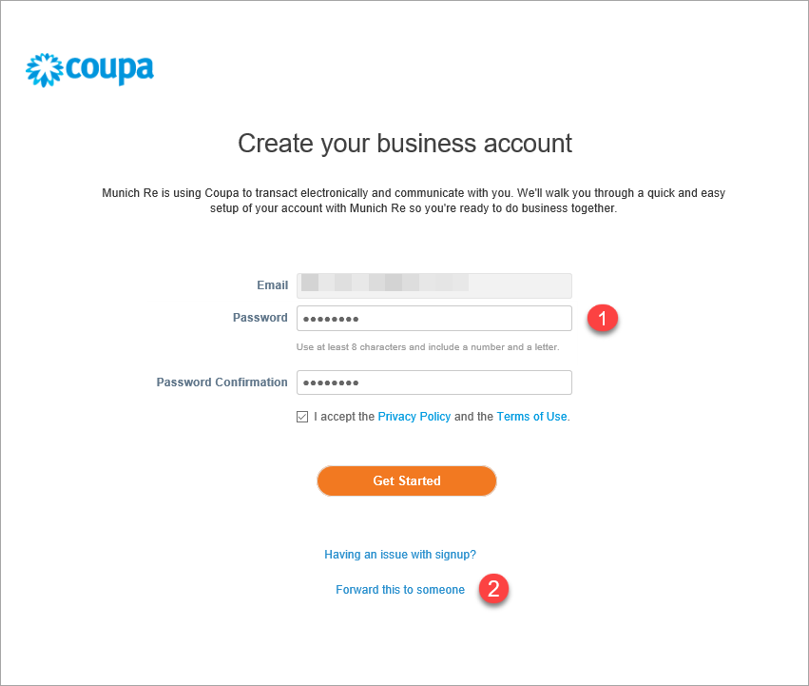
Registration
How to join Coupa Supplier Portal (CSP)
You will first be asked to create your password (1) for the Coupa Supplier Portal.
Once the fields are complete, check the Privacy Policy and review Terms of Use, then check box and click “Get Started”. You will then be asked to complete the Munich Re profile form.
If you are not the right person, you can forward the invitation to the appropriate individual (2).
Note: The language can be changed at any time at the bottom of the Portal.

Slide 18
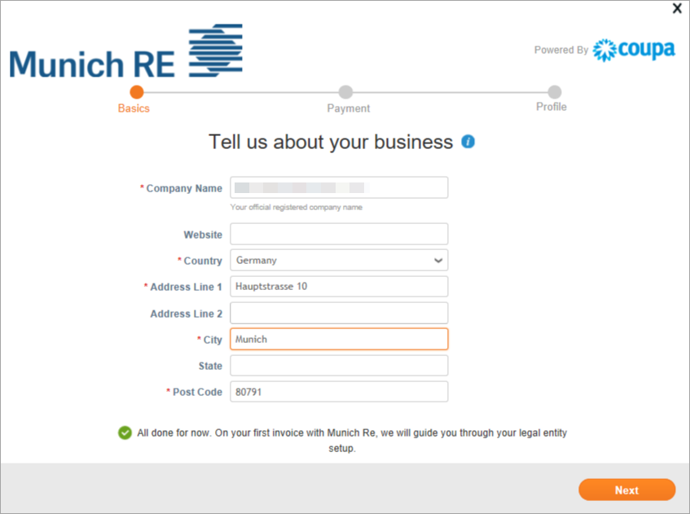
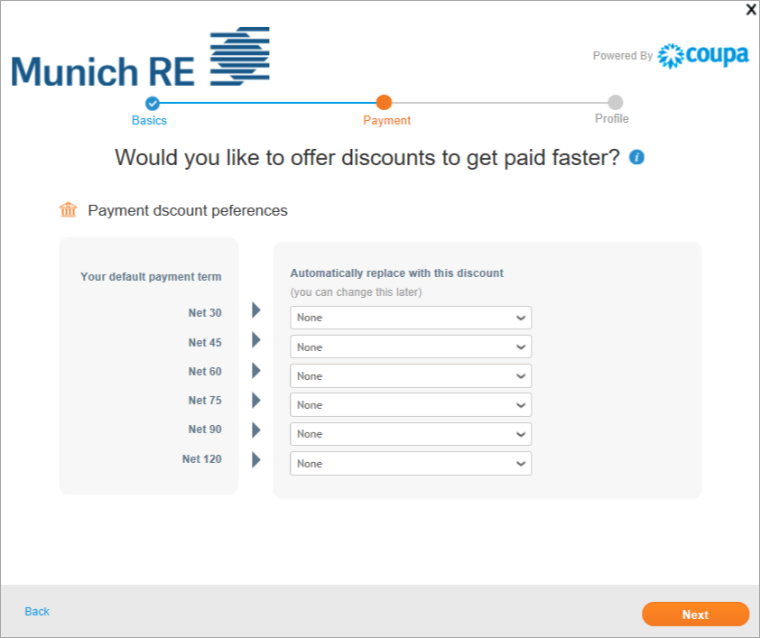
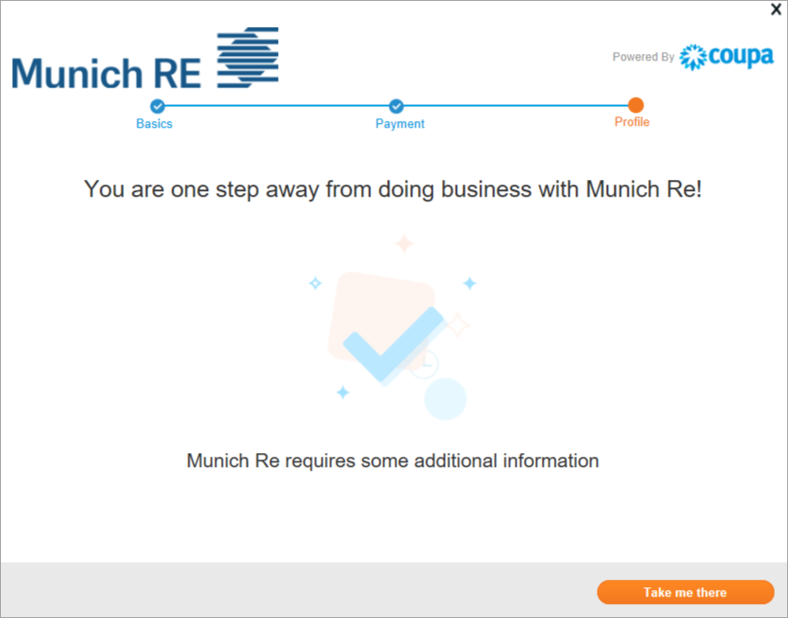
Registration
How to join Coupa Supplier Portal (CSP)
1
Once you have clicked on the “Get Started” button, you will be forwarded to the next screen to enter your address. Click “Next” if you have done the entry.
You are now in the (Terms of) Payment-Screen.
Please do not add the terms of payment here, as these are entered by Munich Re according to your contractual agreements with us.
Please click “Next” to finish this wizard.
2
3
We need now some information in our Munich Re profile form. Therefore please click on "Take me there" to open this questionnaire.

Slide 19
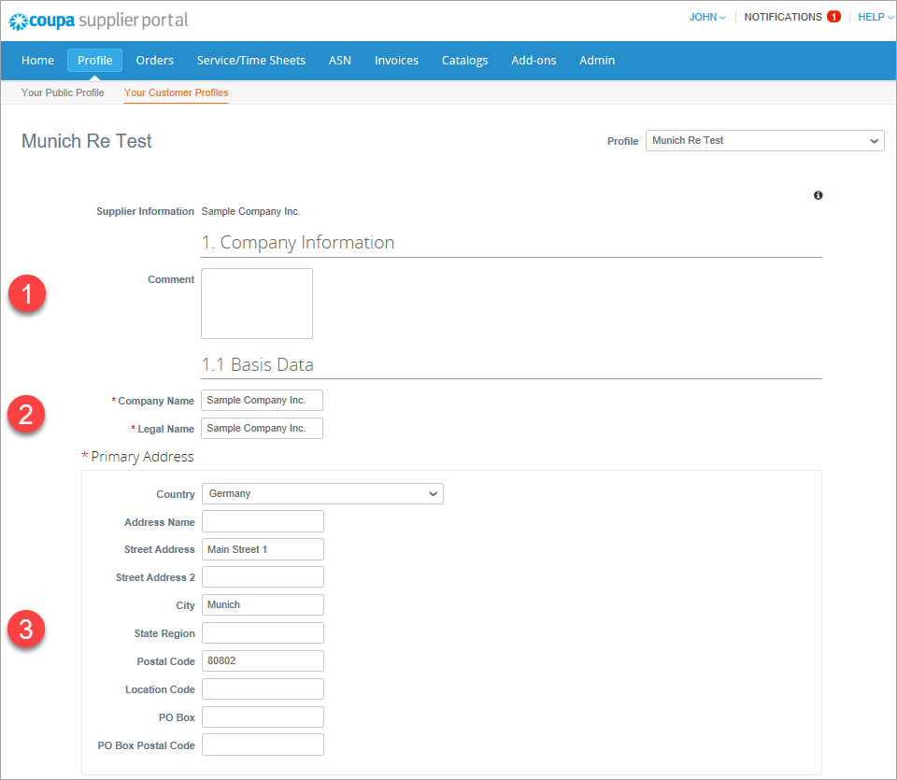
Registration
Completing the Munich Re Profile form
Please complete the questionnaire in the “Munich Re“” profile as follows:
(Some fields may have already been completed by us - please check the data entered and correct if necessary.)
Address:
Please have the following information ready:
Street
Postcode
City
Country
This comment field (1) serves us to send you information in case of an update request. There is nothing to be entered here from your side.
"Legal Name" (2) is the official name of your company.
"Company Name" is the name by which your company is also known. (e.g. "Münchener Rückversicherungsgesellschaft AG" and "Munich Re")
Then enter the main address of your company under (3).

Slide 20
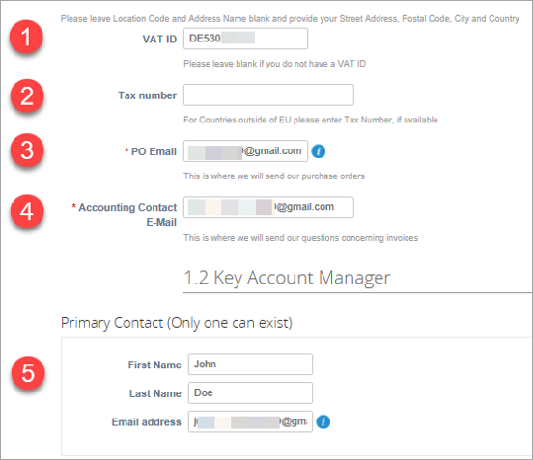
Registration
Completing the Munich Re Profile form
Tax numbers and contact details:
Please have the following information ready:
VAT ID
PO e-mail (the e-mail address to which orders should be sent)
Accounting contact e-mail (the e-mail for your bookkeeping/accounting)
Main contact (e.g. Director, key account, etc.) (first and last name, e-mail address)
Please check that the VAT-ID (1) is entered correctly.
If you do not have a VAT-ID you can enter a different tax number here (2).
The PO email address (Purchase Order) (3) is the email address to which orders are sent in your company.
The Accounting Contact Email address (4) is the email address where we can contact your bookkeeping / accounting department.
Under (5) you can enter the main contact person of your company for Munich Re. (Initially, the contact person for Coupa Onboarding may also be named here. You can change the details at any time).

Slide 21
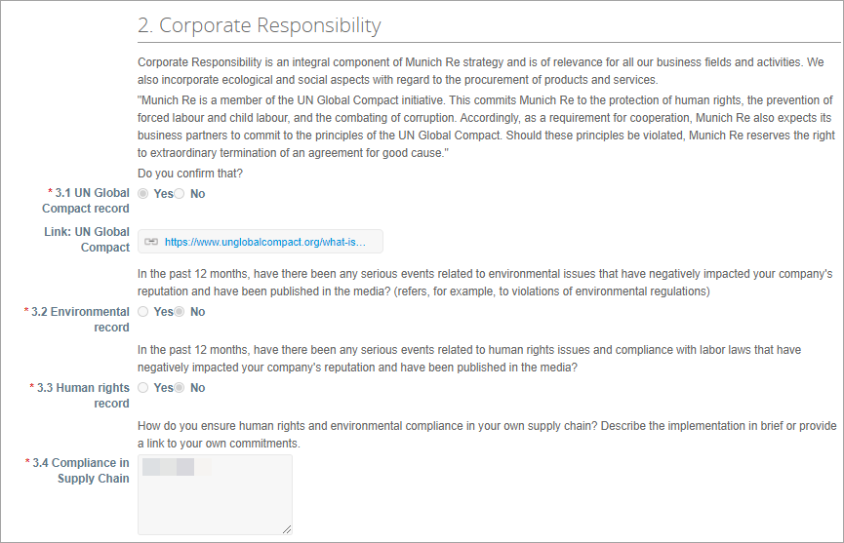
Registration
Completing the Munich Re Profile form
Questions on corporate responsibility:
Question 3.1: Confirm that your company/firm is committed to application of the "10 principles of the UN Global Compact". If not, please state why not.
Question 3.2: Environment: Are you able to confirm that over the last 12 months there have been no serious incidents that adversely affected your company’s reputation or its environmental record, and that no information on events of this nature has been published or distributed? If you are not able to provide this confirmation, please give details of the events concerned.
Question 3.3: Human rights: Are you able to confirm that over the last 12 months there have been no serious incidents that adversely affected your company’s reputation or its human-rights record, and that no information on events of this nature has been published or distributed? If you are not able to provide this confirmation, please give details of the events concerned.
Question 3.4: How do you guarantee compliance with human rights and environment regulations within your own supply chain? Give a brief description of the procedure you have in place or provide a link to your own commitments.

Slide 22
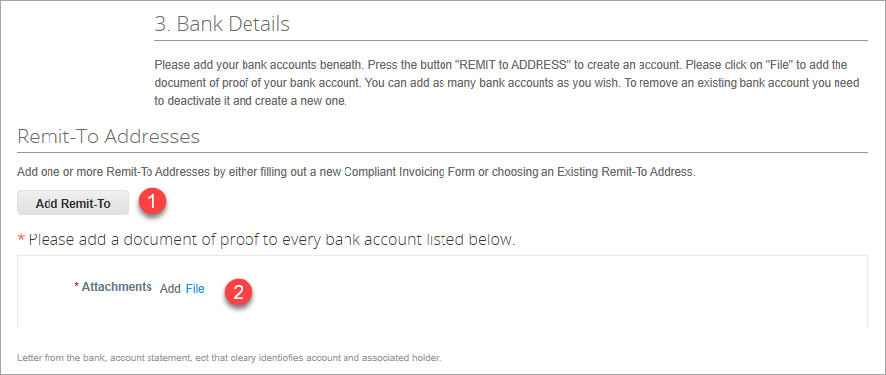
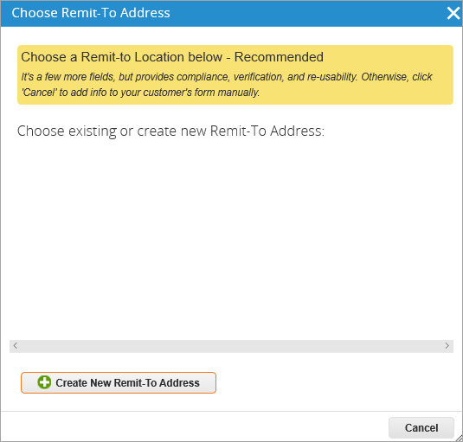
Registration
Bank Account Wizard 1/8
Bank details:
Please attach a document (2) confirming your bank details (account and account holder) that you intend to enter. To do this, click on “File”:
Click on the “Add Remit-To” button (1) to add the recipient of payments (i.e. your bank details). You will then be forwarded to a wizard, which will lead you automatically through the process of setting up your account:
Use the “Create New” button to start the process of setting up the bank data required. A wizard will guide you through the process and the next pages. Complete all of the fields on the following pages.

Slide 23
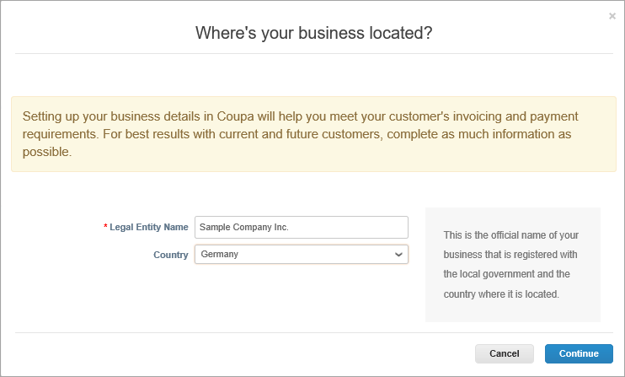
Registration
Bank Account Wizard 2/8
Please have the following information ready:
Name of legal entity
Country
The selected country determines the following questions, which may vary depending on the country. The process for Germany is shown in the following.
Click on the “Continue” button to go to the next step.

Slide 24
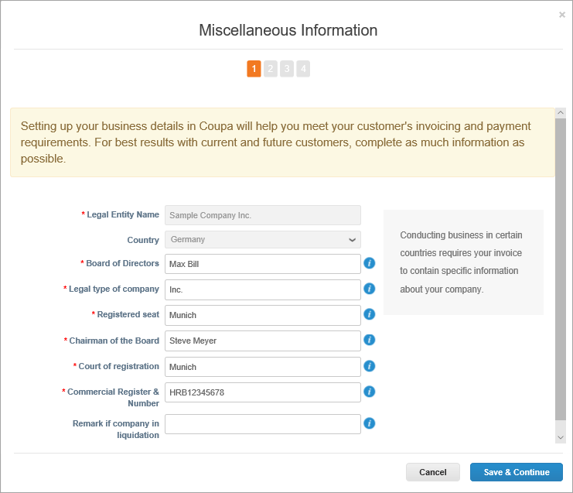
Registration
Bank Account Wizard 3/8
You should enter general information on your company here.
Please have the following information ready:
Directors (names of board directors)
Legal form of company
Registered office
Chief Executive Officer
Registrar of Companies
Number in commercial register
If you do not have a board of directors, enter the manager/owner.
Click on the “Save & Continue” button to go to the next step

Slide 25
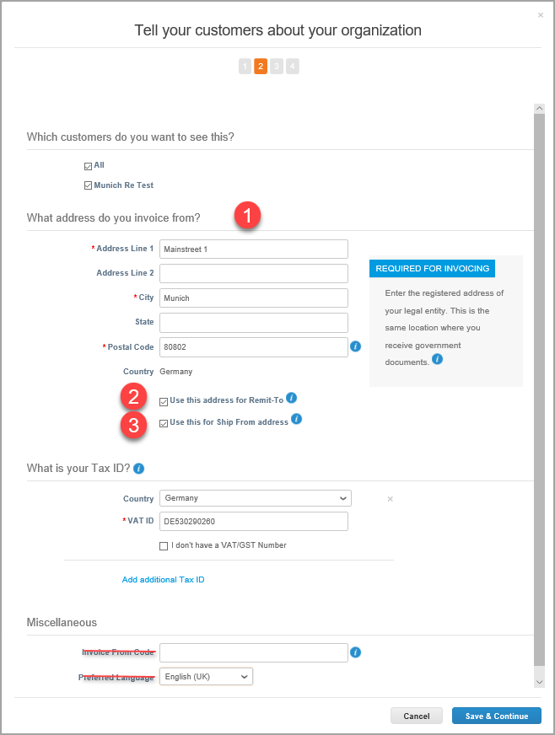
Registration
Bank Account Wizard 4/8
In the next step, you have the possibility of preventing customers from seeing the information entered. You then continue the process, entering the following:
Sender address
Bank account details
Tax number
Enter the information required:
From what addresses will your invoices be issued? Enter the following:
1. An invoice (billing) address The invoicing party's address appears on the invoices; in some countries it is even mandatory. If you have a simple business structure, you may also use this address as the payee and the delivery address. If not, uncheck the boxes to specify a different address for it.
2. A Beneficiary (Remit-To) address Uncheck this box if your payee address is different from the legal entity address or if you have multiple payee addresses.
3. A sender (ship from) address Uncheck this box if your sender address for deliveries is different from your legal address or if you have multiple locations. It is recommended that you include this information on the invoice if the addresses differ. This information is mandatory in many countries.

Slide 26
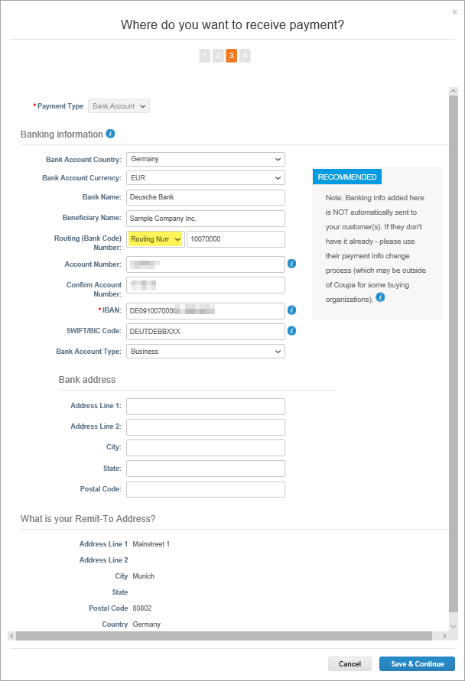
Registration
Bank Account Wizard 5/8
Now enter your bank details. Please enter only one bank account per currency.
We recommend that you complete the following fields even though only the IBAN is a mandatory field because the information will then also be saved in your profile.
Please have the following information ready:
Country of bank account Currency Name of bank Name of beneficiary (optional) Bank code (please select “Routing Number”) Account number IBAN SWIFT/BIC (if your SWIFT/BIC is shorter than 11 characters, please fill up with “X”) Type of bank account Address of bank (optional)
Click on the “Save and Continue” button to confirm the information you have entered.

Slide 27
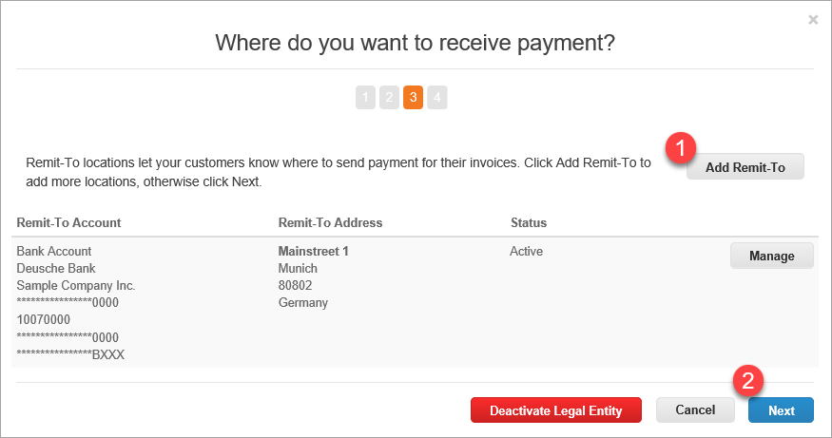
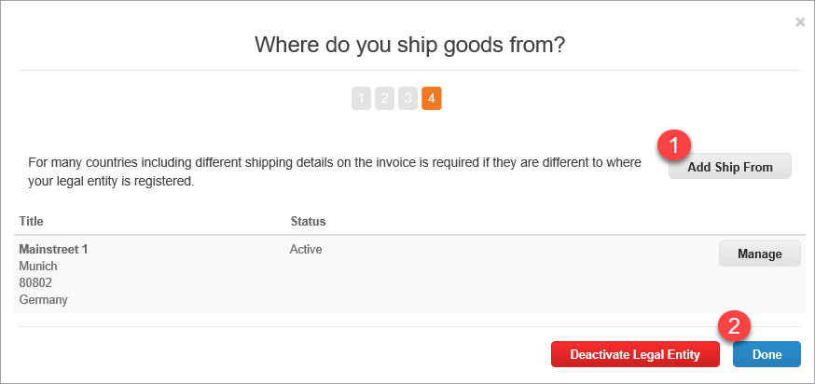
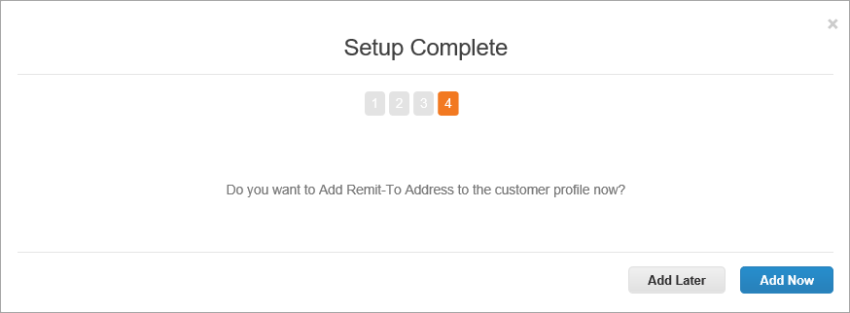
Registration
Bank Account Wizard 6/8
In the next step, you may add more beneficiaries if you wish. If no further beneficiaries are to be set up, click on Next.
Where would you like to receive payment?
If you would like to receive payments at an address other than that entered above, click on “Add Remit-To” and add a new address.
If you wish to use the same address, click on “Next”.
Where do you ship goods from?
If you send goods from a location other than that at which your legal entity is registered, click on “Add Ship From” and add a new address.
If you wish to use the same address, click on “Done”.
If all data has been saved, you return to the basic data entry form overview by clicking “Add now”.

Slide 28
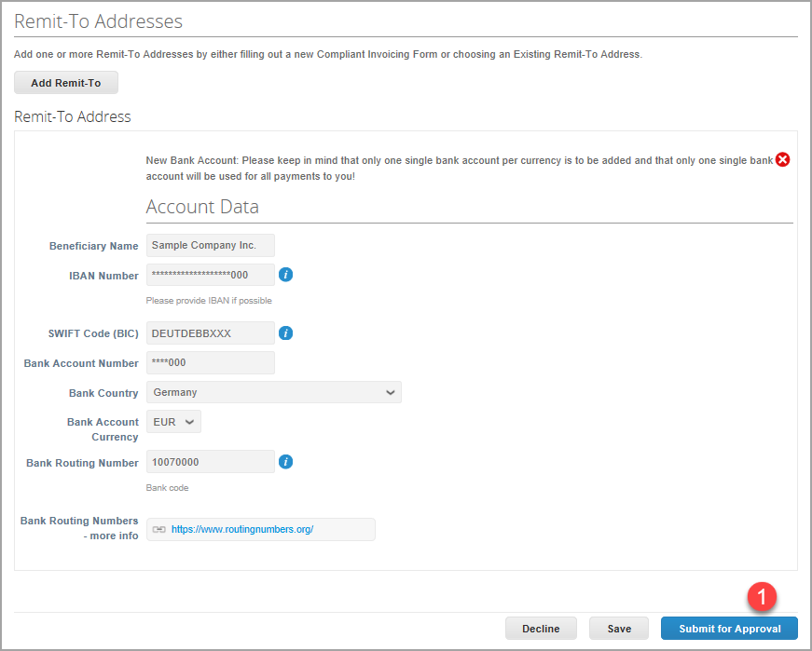
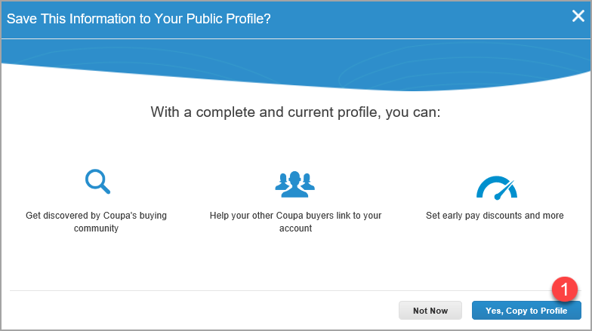
Registration
Bank Account Wizard 7/8
You should now see the account details just entered. You can then finish the process:
Use the “Submit for Approval” button (1) to transmit the information to Munich Re for checking and approval:
You can now also copy the information into your public profile (1):

Slide 29
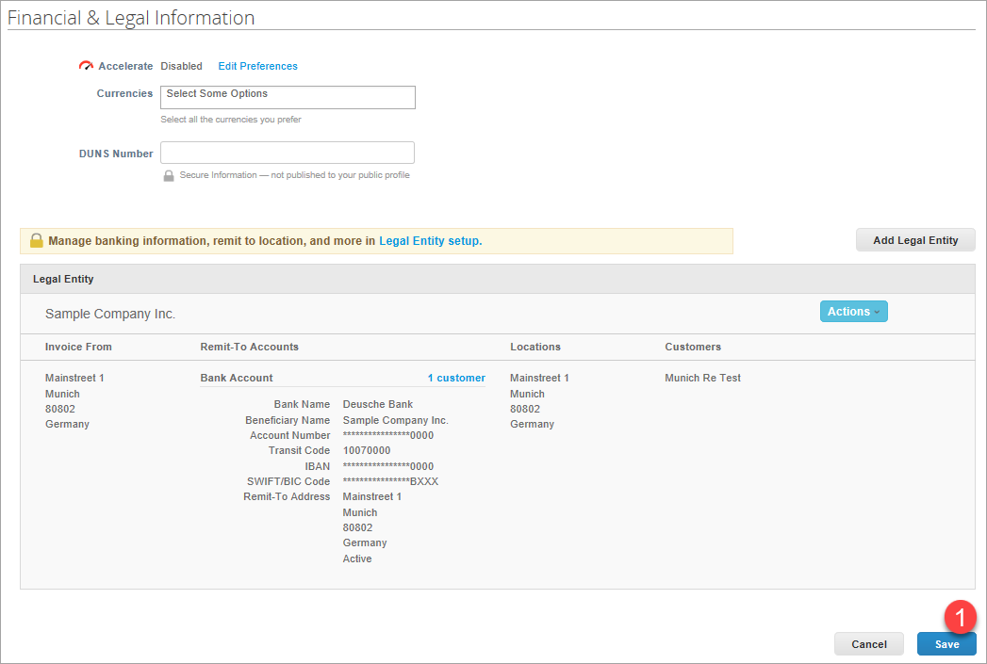
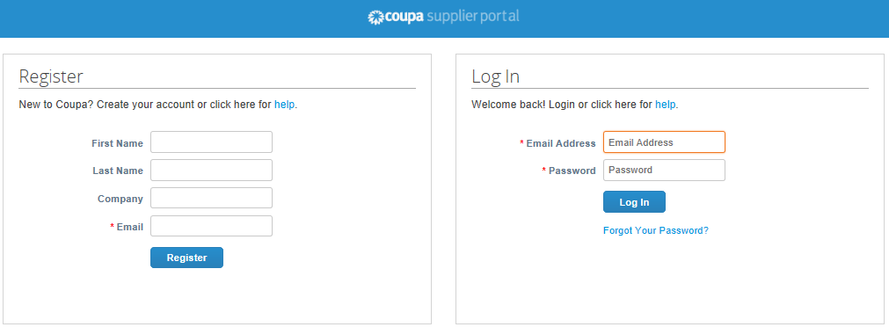
Registration
Bank Account Wizard 8/8
You can then see your entered data in your profile under “Legal entity”:
Click on the “Save” button (1) to finish this step.
Congrats! You have now completed set-up in the CSP and can wait for approval from Munich Re.
As soon as you receive confirmation from Munich Re, we’re ready to go!
By the way:
As soon as you log in again in the Coupa Supplier Portal (https://supplier.coupahost.com/), you will see this window. You can log into the CSP with your e-mail address and password:

Slide 30
Manage your Account
3

Slide 31
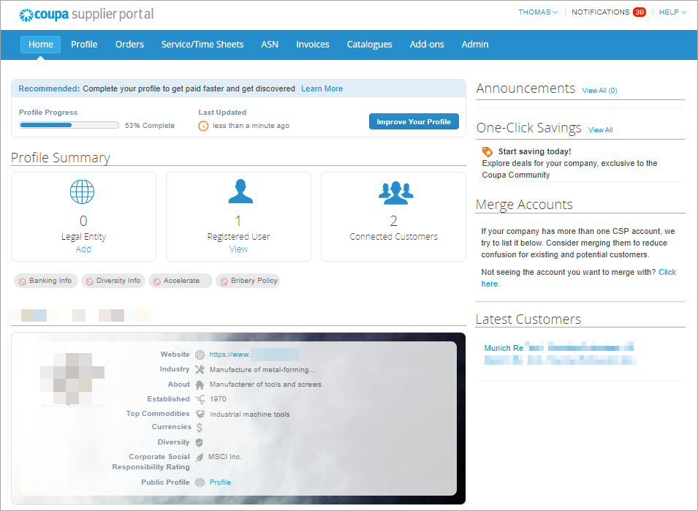
Manage your Account
Home-Screen
Once you click the emailed link and sign up for the CSP, you will find the Home-Screen with a rough summary about (your internal) registered users and customers you are connected with via the CSP.
In the middle of the home page, is an "Improve Your Profile" button. This will allow you to add various pieces of information about your company to your public profile. Please note that any changes you make to your public profile will be available to any of your customers that are using Coupa, not just Munich Re.
On the right-hand side you are able to Merge Accounts if you have multiple Coupa Supplier Portal accounts.
At the top is the Admin tab
At the top you find also your user-settings
Access to public and customer profiles
Access to manage orders of your customer
Access to manage invoices to your customer
Notifications sent to you (optional as e-mails)
5
9
6
7
8
4
2
3
1

Slide 32
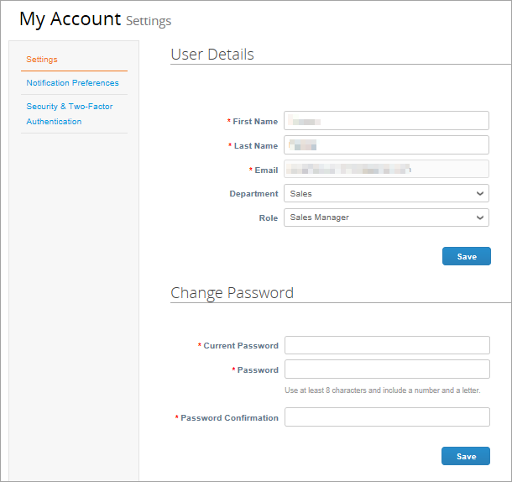
Manage your Account
Account Settings
Once, you click the emailed link and sign up for the CSP, you can manage your account information.
Click on your user and Account Settings.
Edit your first name, last name, email* and password.

Slide 33
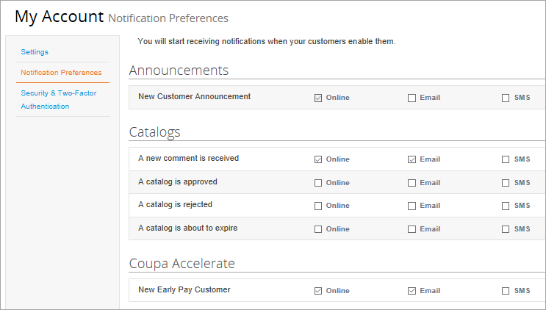
Manage your Account
View and Manage Notifications
On the Notification Preferences page, you will be able to select notifications you want to receive as well as the channel where you want to receive the notification: online (“Notifications” in the CSP) - recommended, email - recommended, or SMS* (short text message).
(* SMS: You can choose to receive notifications in short text messages only if you have an SMS-capable device and you validate your phone number. SMS notifications are turned off by default. Your SMS notification selections are deleted if you disable mobile phone verification. You can verify your mobile phone for SMS notification receiving on Security and Two-Factor Authentication page.)

Slide 34
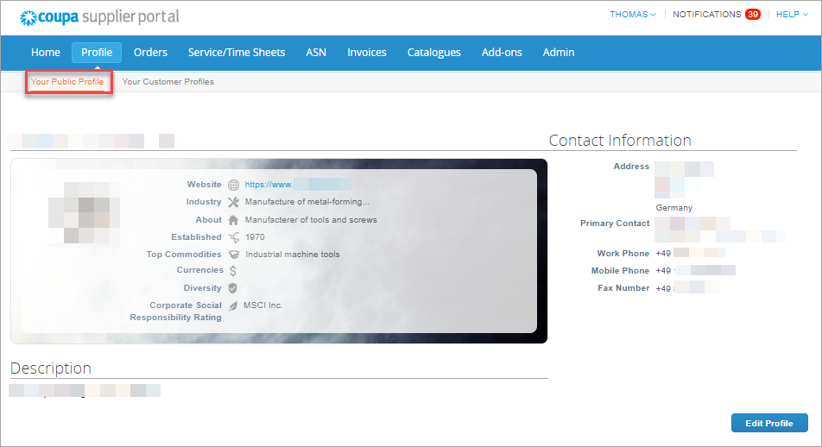
Manage your Account
Updating your Public Supplier Profile
Once, you click the emailed link and sign up for the CSP, you can verify and complete your Profile information.
Select Profile – Your Public Profile from the top menu bar.
Edit Company Info
To start, complete your Public Profile*:
*Public profile is what other Coupa customers, aside Munich Re, can see about your company on the CSP.
You can also edit specific profiles for each customer (Your Customer Profiles).
Click Edit Profile
Confirm existing company information and complete any missing fields in at least the General Information, Address, Primary Contact sections (Required fields are marked with an asterisk)
Click Save when finished
Only information within the customer profile of Munich Re will be transferred to Munich Re system.

Slide 35
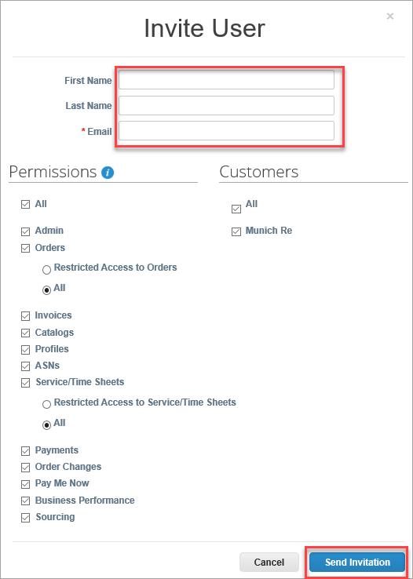
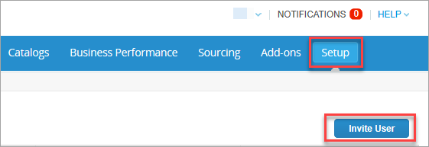
Manage your Account
Invite internal Users 1/2
If desired, you can allow additional users access to
your supplier account to perform all tasks*:
(*You can manage user permissions and customer access by assigning certain users to only certain customers and by limiting what types of documents they can access and what functions they can perform with their assigned customers.)
Add Users
From the top menu bar, select Admin, then click Invite User
Enter at least the employee’s email address in the Invite User popup window and click Send Invitation
You can restrict access to specific customers and permissions by checking/unchecking customer name boxes and permission boxes in the user table

Slide 36
Manage your Account
Invite internal users 2/2
Notification sample
After you have sent the invitation, the employee will receive an email notification, with a link to register.

Slide 37
Manage your Account
Editing Users
You can edit and manage individual user access at any time:
Edit Existing Users
From the top menu bar, select Admin, then click Edit under the desired User’s name
Modify the specific permissions and customer access by checking/unchecking respective boxes in the popup window user table
Click Save when finished
For auditing purposes, Coupa doesn't allow users to be deleted. You can deactivate a user when you no longer want that user to be able to access the account. You can also reactivate users later.

Slide 38
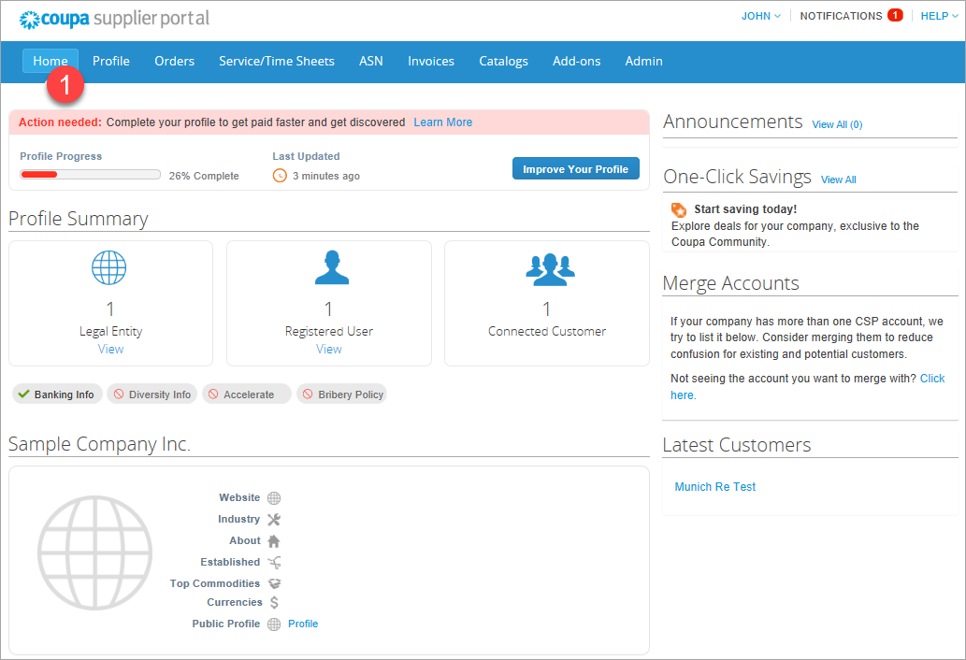
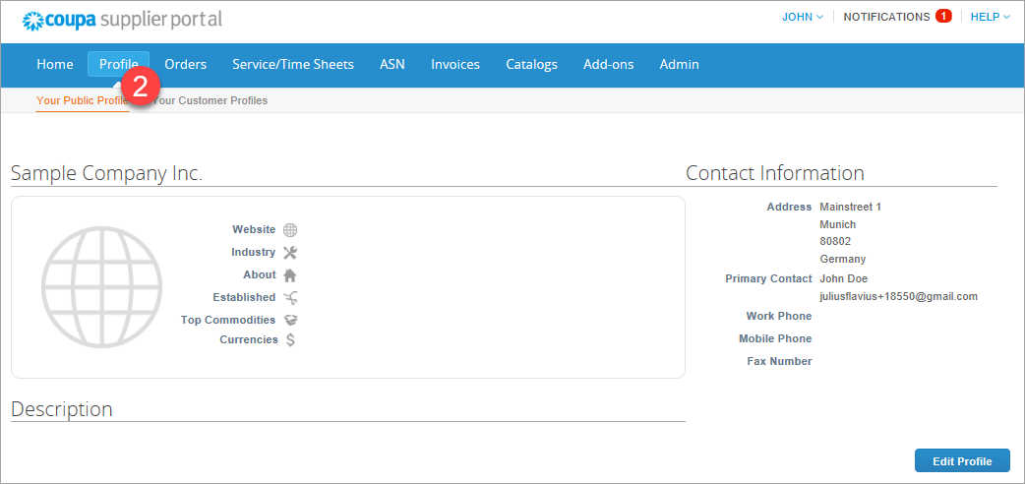
Manage your Account
Setting up and maintaining your profile
Once you have registered for the CSP, complete the information on your company. You can make changes directly from the homepage by using the “Improve your Profile” button or the Profile button in the menu.
Option 1: Amend your profile via the homepage (1)
Option 2: Amend your profile via the Profile menu item (2)

Slide 39
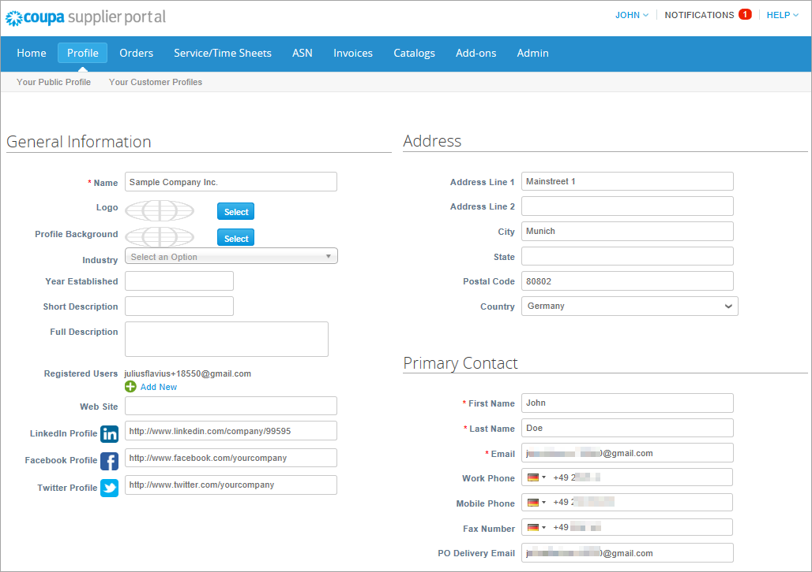
Manage your Account
Public and client-specific company profiles
There are generally two different profiles:
Public profile: contains general information on your company (e.g. name, logo, area of activity, number of employees, profiles in social networks or contact information). Your public profile enables other companies to find your company in the Supplier Portal Register and then contact you. The public information is stored in the General information area.
Client-specific company profile: contains general information of interest to customers or suppliers such as addresses, contact persons and contact details, and corporate identity information (DUNS and VAT number).
Note: Changes to the client-specific company profile are forwarded directly to Munich Re, and our basic data system is updated.
Data for the client-specific company profile is stored in the Company details area.
When you have made all the changes, click on “Save”.

Slide 40
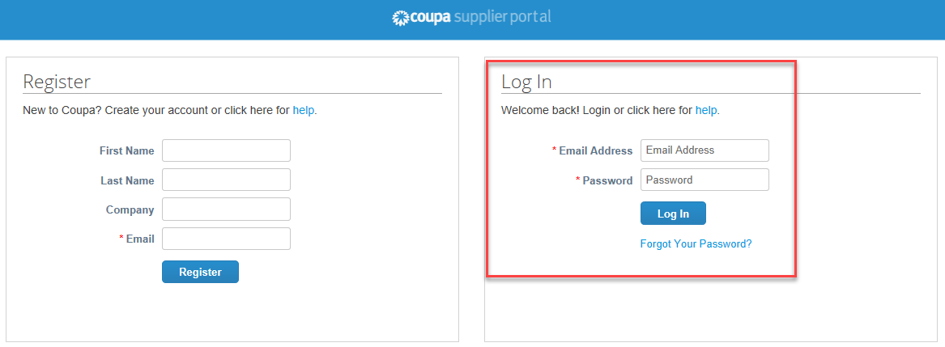
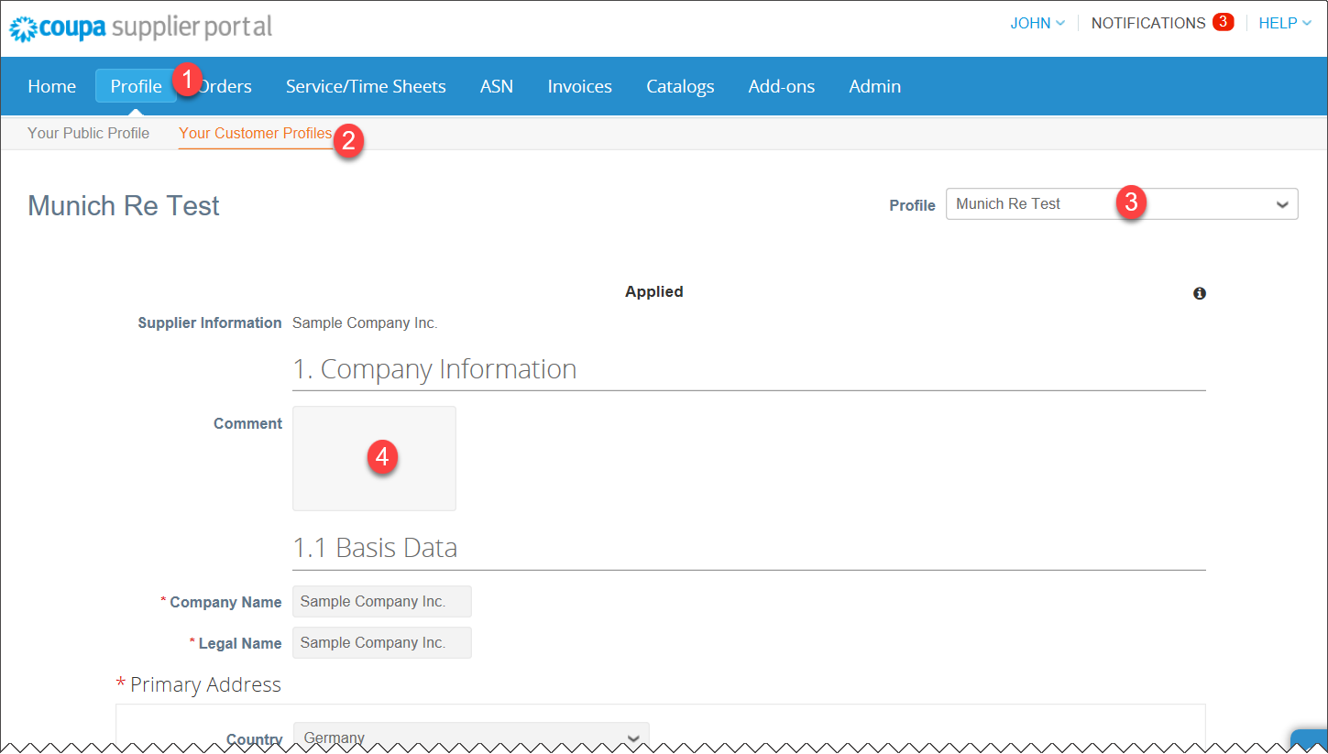
Manage your Account
Process for updating information - Changes/updates at vendor’s request
Log in to CSP
Choose from the top navigation "Profiles" (1) - "Your Customer Profiles" (2) .
Then select the profile of the customer you want to change (3) .
In the “Comment” field we will address our reason for the change request. (4)
With the button "Update Info" (5) you can enter the edit mode of the form.

Slide 41
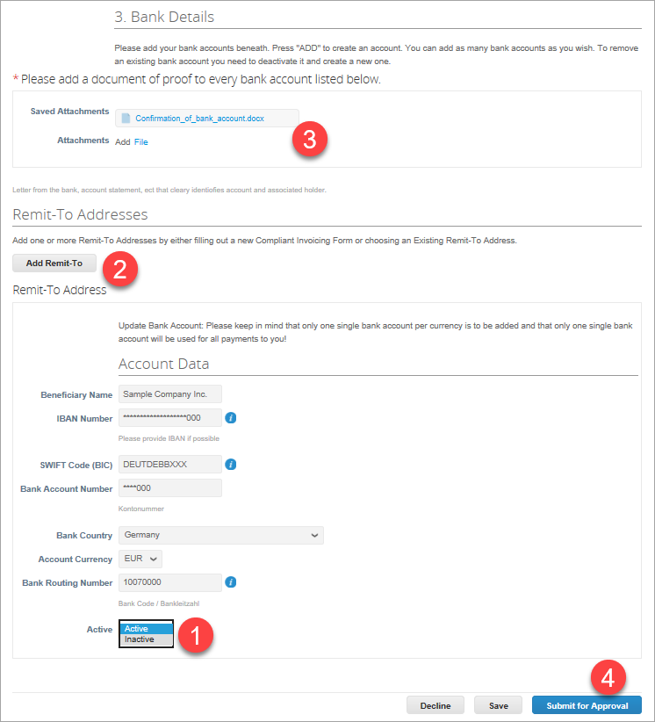
Manage your Account
Process for updating information - Changes/updates at vendor’s request
If you want to update and change data, you can do this in the update process by simply overwriting the current data.
When changing bank data, please note that only a complete bank data record can be updated.
This means that you have to set the existing bank data record to be updated to Inactive (1), then
add a new bank data record (2).
Don´t forget adding the proof of bank account (3):
To complete the change process, click on the “Submit for Approval” button (4) to forward the update to Munich Re for approval.

Slide 42
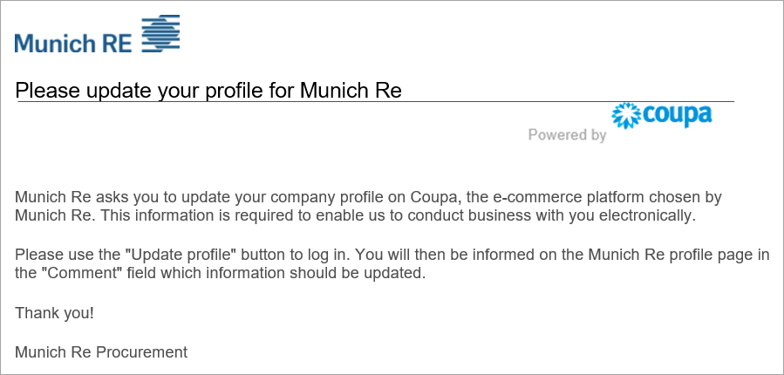
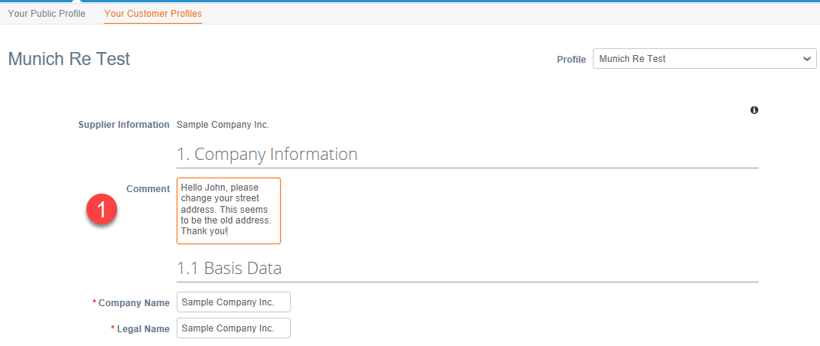
Manage your Account
Process for updating information - Changes/updates at Munich Re’s request
If Munich Re needs your data to be changed or updated, you will receive an e-mail from Munich Re requesting you to make the changes. Please use the “Update Profile” button to log in.
You will find more information on the need for changes in the upper comment field (1) on the Munich Re profile page.
Please save your input when the changes have been made and submit for approval to Munich Re.

Slide 43
Purchase Orders
4

Slide 44
Purchase Orders
PO Transition Strategy
Your current open POs will go through a transition period. The PO transition strategy will have two scenarios:
PO sunset strategy :
The old POs will continue to be invoiced as usual, through the old invoicing method you are using today, until they are completed.
All new POs, sent to you after the Go Live date of July 6th, will be sent through Coupa. As a result, all invoices for these new POs need to be submitted through Coupa.
The old invoicing method will NO LONGER be in operation after the Go Live date for new Pos at July 6th.
PO cutover strategy :
Open POs will be converted from our legacy system to Coupa. Converted POs will have a new PO number. The new PO number will be communicated to you in a separate communication, once the transition is completed.
To be able to migrate the POs to Coupa we will have a short blackout period in which we will not be able to process invoices or create new POs. The short blackout period for invoicing against the cutover POs will be communicated to you in a separate communication.
Please DO NOT submit invoices during the blackout period, as they will not be processed.

Slide 45
Purchase Orders
Receive & View Orders (1/2)
Regardless of the PO delivery preference set, you will have access to POs within CSP.
Select Orders from the top menu bar.

Slide 46
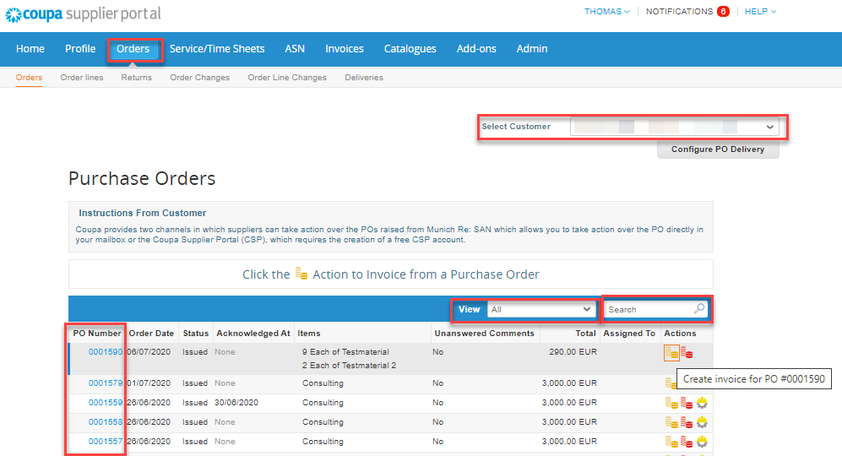
Purchase Orders
Receive & View Orders (2/2)
A Purchase Orders screen will display and show all purchase orders sent by Munich Re. Please choose Munich Re at Select Customer.
To find purchase orders, you can use the Search functionality. You can also sort by column headers by clicking on any of the column headers (PO Number, Status, Acknowledged At, Items, Unanswered Comments, Total, and Actions).
In addition, as you start to receive multiple purchase orders, you can use the View functionality to filter the purchase orders.
All purchase orders on this screen are hyperlinked, and you can view additional information about the purchase order by clicking on that blue hyperlink, i.e. PO Number.

Slide 47
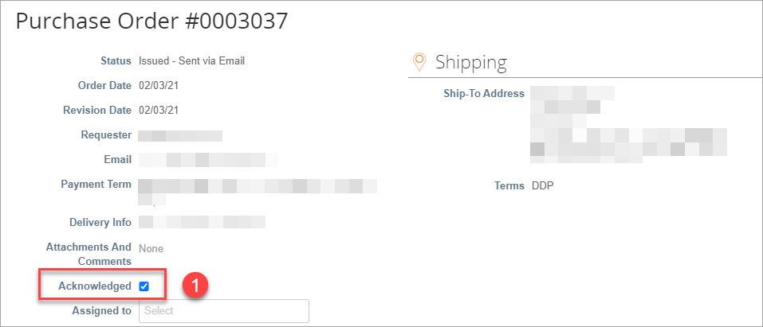
Purchase Orders
Acknowledge Orders
The page refreshes to display the PO details and shipping address.
Check the Acknowledged box (1) to let the requester know that you have received the PO and will act. Munich Re can see the status update.
(*If you do not agree with any aspect of the order, please send your concerns or requests to the requester’s email address)
You can print the PO in PDF version by clicking Print View.

Slide 48
Invoices Creating Electronic Invoices with Coupa
5

Slide 49
Invoices – Coupa Supplier Portal (CSP)
CSP Orders – Viewing orders
The Orders tab at the top of the home page will display all Purchase Orders sent by Munich Re. Use the Search functionality to find purchase orders by number. You can sort by column, by clicking on any of the column headers (PO Number, Status, Acknowledged At, Items, Unanswered Comments, Total, and Actions). View functionality should be set to “All”.
All purchase orders on this screen are hyperlinked and you can view additional information about the purchase order by clicking on the blue PO# hyperlink.
If you’re not seeing a particular PO you may need to select one of the other Munich Re customer records using the Select Customer dropdown.

Slide 50
Invoices – Coupa Supplier Portal (CSP)
CSP Orders – Viewing orders
Set your PO delivery preferences by clicking the Configure PO Delivery button.
Let Munich Re know how you’d like to receive purchase orders by entering an email address or cXML credentials. For cXML requests, please reach out to us at: Procurement@munichre.com

Slide 51
Invoices – Coupa Supplier Portal (CSP)
CSP Orders – Viewing orders
When you click on a purchase order blue hyperlink the purchase order will open.
At the top it will show you:
Status,
Order Date,
Revision Date,
the original Requester,
the requester’s Email,
the Payment Terms you’ve negotiated with Munich Re,
Attachments.
In the upper right hand corner you can see the shipping address.

Slide 52
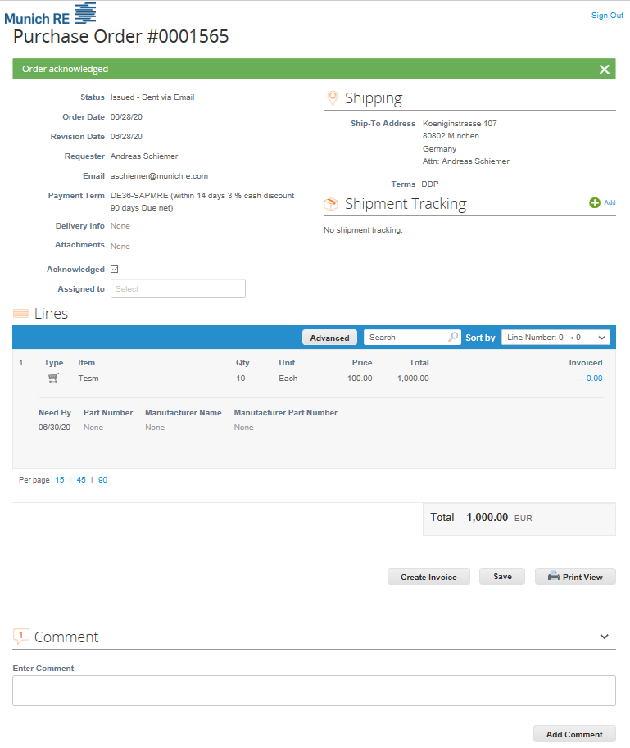
Invoices – Coupa Supplier Portal (CSP)
CSP Orders – Viewing orders
Scrolling down you can see the Lines on the purchase order. Here you can see:
The type of order QTY or AMT
Quantity Ordered and Price
A Description of what has been ordered
How much has been invoiced against the purchase order.
By clicking on "acknowledged" you confirm the receipt and content of the order.
Create Invoice will take all of the PO information and turn it into an invoice.
Print View will open another window displaying additional information, such as currency and contact information and Munich Re Terms & Conditions.
The Comments section will allow you to add comments to the purchase order.

Slide 53
Invoices – Coupa Supplier Portal (CSP)
CSP Orders – Creating an invoice
As seen in the previous slide, you can create an invoice by clicking on the create invoice button when you review your PO.
You can also create an invoice in the Orders view.
On the Home page of the Coupa Supplier Portal click on the “Orders” tab.

Slide 54
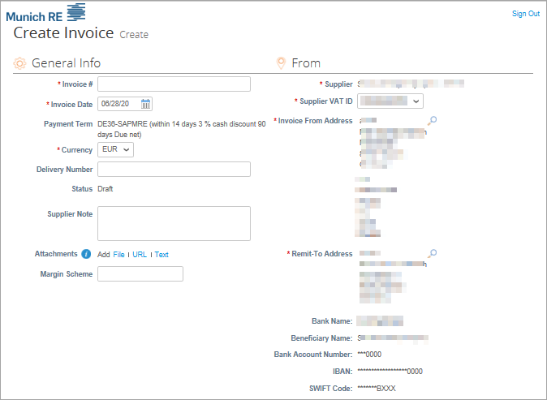
Invoices – Coupa Supplier Portal (CSP)
CSP Orders – Creating an invoice
Click the Gold Stack of Coins in the actions column of the purchase order you want to invoice.
You will be taken to the Create Invoice page and the Choose Remit-To Address pop-up will display. Select the address you would like to remit-to by clicking Choose.
If there is only one Remit-To address stored in your profile, then Coupa will default to that address and there will be no pop-up to choose an address. If there is no Remit-To address stored, Coupa will ask you to create one. After the address is selected/entered, you can begin to build the invoice.

Slide 55
Invoices – Coupa Supplier Portal (CSP)
CSP Orders – Creating an invoice
Invoice # field: Please enter your invoice number which has been created within your finance system. This will be the identification, on your bank account to identify the corresponding payment. If you do not have a finance system, it is your choice how the invoice number is created.
Currency: Please create the invoice in the currency in which the purchase order was created.
Supplier Note: Please add here information to Munich Re
Attachments: Here you can attach a related document to the invoice (time sheets, excel sheets, PDF etc.)

Slide 56
Invoices – Coupa Supplier Portal (CSP)
CSP Orders – Creating an invoice
Go to the “Lines” section of the invoice, where you can review (and update if applicable) the value being invoiced.
If applicable, in case of an Amount based PO update the amount in the “Price” field with the amount you are invoicing. Delete the value shown and enter your invoice amount .
If applicable, in case of a Quantity based PO update the quantity in the “Qty” field with the quantity you are invoicing.
Note: If you do not wish to include a particular order line in the current invoice, please remove this order line by removing the line by clicking on the red X.

Slide 57
Invoices – Coupa Supplier Portal (CSP)
CSP Orders – Creating an invoice
Please select the VAT rate from the drop-down menu which applies to the respective line item. VAT-Amount will be automatically calculated. Please note that it is a mandatory field.
If applicable, use the Tax Reference section to
provide justification on the selected VAT Rate.
If you have any additional charges (e.g. shipping, handling, etc.), please add a line by clicking on the add Line button
Note that if a 0% rate or a tax exemption is applied, a justification must be provided in the Tax reference Box.

Slide 58
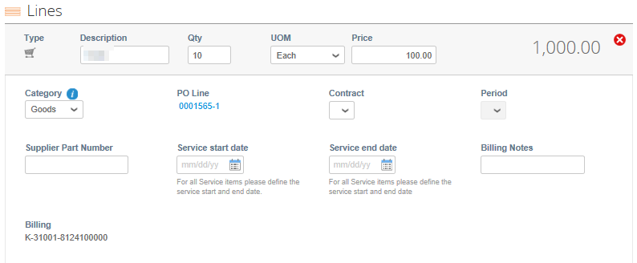
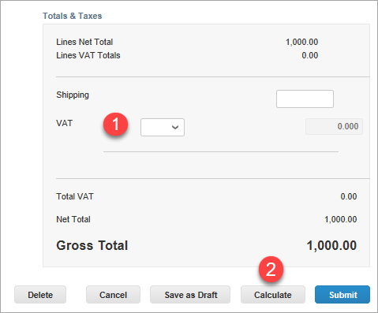
Invoices – Coupa Supplier Portal (CSP)
CSP Orders – Creating an invoice
For any additional lines, add, in the Description box, the type of charges, and fill in the amount of the charge in the “Price” field .
Please select the VAT rate (1) from the drop down menu which applies to the respective line item. VAT Amount will be automatically calculated. Please note that it is a mandatory field.
If applicable, use the Tax Reference section to provide justification on the selected VAT Rate
Click the calculate button (2) just under the Totals and Tax section : This will update the total value being invoiced based on the amount in the “Price” field above and any additional charges entered.

Slide 59
Invoices – Coupa Supplier Portal (CSP)
CSP Orders – Creating an invoice
Click on the Submit button
Please acknowledge that Coupa will create an invoice on your behalf and Click the “Send Invoice” button in the pop up.
Coupa generated PDF invoice is the only legal invoice for you and Munich Re. Coupa is creating an invoice on your behalf.
Please make sure you are not attaching another invoice to this transaction as the Coupa generated PDF is your and Munich Re´s legal invoice.
Congratulations, your invoice is now submitted!
Once invoices have been received/reviewed the status will updated automatically.

Slide 60
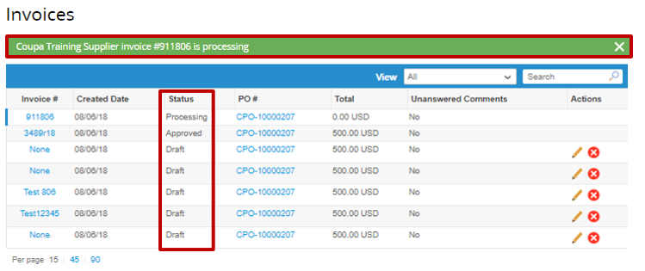
Invoices – Coupa Supplier Portal (CSP)
CSP Orders – Creating an invoice
After the invoice is in Approved status, it will be paid according to the payment terms and payment schedule contractually agreed upon between Munich Re and the supplier.

Slide 61
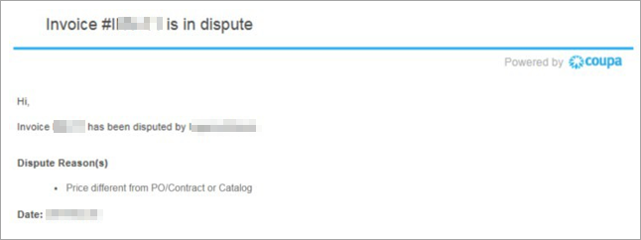
Invoices – Coupa Supplier Portal (CSP)
Disputed Invoice
There are several reason an invoice can be disputed:
An automated dispute will happen immediately after the invoice is submitted.
The invoice does not match what is on the PO. This could be a part number issue, a quantity issue or a price issue.
A manual dispute done by the PO Owner/Requestor.
How will I know if my invoice is disputed?
You will receive an e-mail notification with the invoice number and the dispute reason (see below).
Any disputed invoices will also show in your To Do and Notifications tab on the Coupa Supplier Portal.

Slide 62
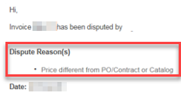
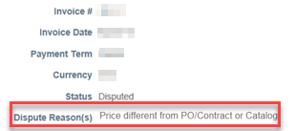
Invoices – Coupa Supplier Portal (CSP)
Resolving a Disputed Invoice
First, you’ll need to review the reason for dispute. If there is no reason listed or its unclear what the issue is, please reach out directly to the PO requestor for details.
Example of what the e-mail notice will look like:
Example of what the disputed invoice will look like in Notifications:
Next you’ll start the invoice resolution process.

Slide 63
Invoices – Coupa Supplier Portal (CSP)
Resolving a Disputed Invoice
From the invoice page find your disputed invoice and click the “Resolve” button in the Actions column. This will take you into the invoice.
You can also click the “View Online” button in the dispute e-mail or enter through the notifications tab and you will be taken directly into the invoice.

Slide 64
Invoices – Coupa Supplier Portal (CSP)
Resolving a Disputed Invoice
There are two options when resolving an invoice:
Void: If this invoice is a duplicate, if PO is over invoiced or invoice is invalid you can void the invoice. Click the Void button at the bottom of the invoice.
Correct Invoice: If the disputed invoice has some incorrect detail please choose this option to make changes to the invoice and resubmit.
Click the Correct Invoice button at the bottom of the invoice.
Once you’ve clicked the correct invoice button you will be taken back into the invoice. (Similar to when you created the invoice).
In the example above invoice was disputed because the price was not matching with the PO price.
To resolve you will update the “Price” field.
Once the price is entered, scroll to the bottom and click “Submit”.
Assuming there are no other issues, this will resolve the dispute and the invoice will flow into the payment process.
Other disputes, such as Quantity discrepancies can be resolved by correcting the corresponding fields.
For any questions regarding this process, please reach out to us at Procurement@munichre.com

Slide 65
Credit Notes in Coupa
6

Slide 66
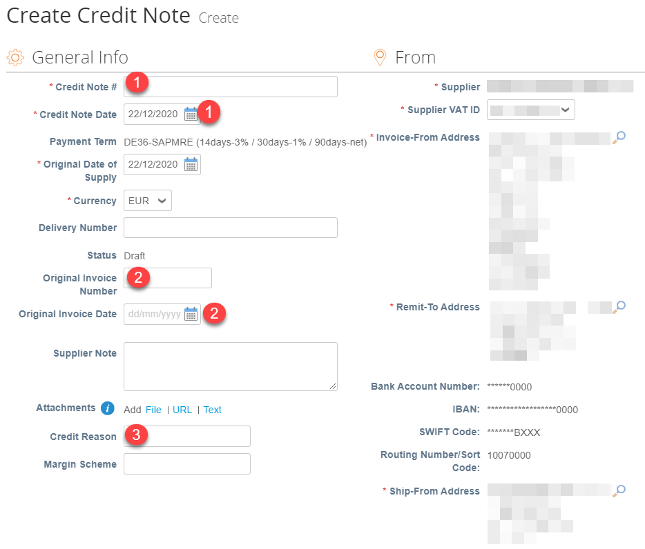
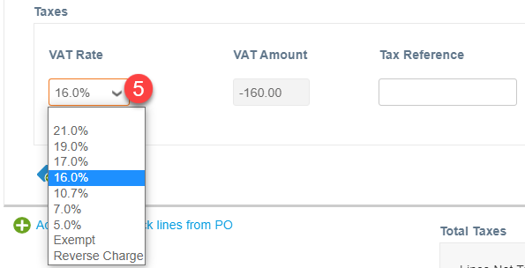
Creating a Credit Note for Munich Re 1/3
Option 1
In the “Purchase Orders” tab choose the red coins icon associated with that PO from the Purchase Orders table. The Credit Note creation screen is similar to the invoice creation screen but contains additional fields which you should populate such as “Original Invoice Number”. Fill out the header level information. Mandatory fields are indicated with a red asterisk*.
1. Input your credit note number and Date.
2. Input your Original Invoice Date and Original invoice Number.
3. Add a Credit Reason.
4. At the line level enter the quantity or the amount that you wish to credit as a negative number.
5. Choose the appropriate tax code from the “VAT Description” dropdown.
6. When completed, select “Calculate” to see the gross value of the invoice.
7. When completed, select ”Submit”.
8. You will be asked to confirm the value via a pop-up window.

Slide 67
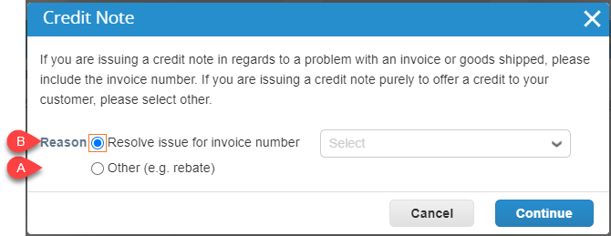
Creating a Credit Note for Munich Re 2/3
Option 2
In the “Invoices” tab you will find a “Create Credit Note” button.
1. Click on the “Create Credit Note”. You will have the choice between two options :
a.). Issue a credit note purely to offer a credit. You will have then to select “Other”. You will then be redirected to the screen to create the credit note as in Option 1.
b.) Issue a credit note regarding a disputed invoice. You will have then to select “Resolve issue” and select from the drop-down list the invoice number. You can choose to issue a credit note to completely cancel the invoice or to adjust invoice with a credit note (only quantity or price can be reduced through this adjust invoice). Choose one option and a window with creating Credit Note will appear similar to Option 1.
You can edit only the following fields: Credit Note Number, Credit Note Date and Credit Reason. The other fields are pre-populated and not editable so that all the information is carried over from the original invoice. When approved, the credit will fully cancel/adjust the invoice's impact to the transaction.

Slide 68
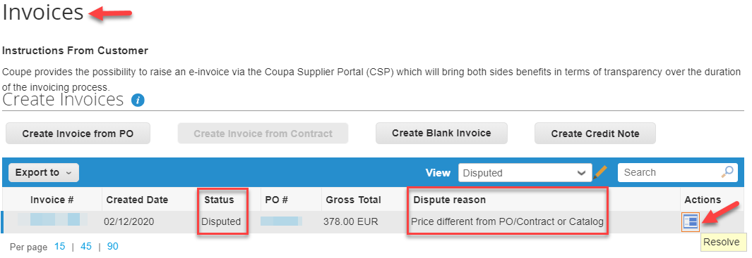
Creating a Credit Note for Munich Re 3/3
Option 3
When you have an invoice in dispute status option 3 is highly recommended:
1. In the “Invoices” tab you can find your disputed invoice. To credit these invoices, you can click the “Resolve” icon in the Actions column..
2. This will take you into the invoice to review it and choose between “Void” the invoice or “Correct Invoice”. Depending on the reason for rejection, click the option of your choice..
3. You will be redirect to a window to create your Credit Note.
Like Option 2, you can edit only the following fields: Credit Note Number, Credit Note Date and Credit Reason. The other fields are pre-populated and not editable so that all the information is carried over from the original invoice.
When approved, the credit will fully cancel/adjust the invoice's impact to the transaction.
4. After submitting your credit note, Coupa will ask you if you want to create a new invoice to replace the one you have just cancelled. Click on the option of your choice according to the reason for rejection.

Slide 69
Support
7

Slide 70
Support
Additional resources
The purpose of this training slides is to review best practices and provide a training overview for working with Munich Re via Coupa. This document will not be addressing other potential areas of interest, such as Coupa punch-out or cXML.
We recommend the following links to learn more about Coupa and Munich Re processes:
Munich Re Procurement: https://www.munichre.com
General information about Munich Re and Coupa
Information about different options to manage orders, invoices and credit notes from/to Munich Re
Supplier Quick Registration Guide
Reference guide / Overview for working with Munich Re via Coupa (this slide-deck)
General Terms and Conditions
FAQ
We recommend the Coupa Success Portal for additional info, videos and help: https://success.coupa.com
Coupa Supplier Portal Log In: https://supplier.coupahost.com
If you have any questions, please contact Munich Re’s Coupa Procurement Team: Procurement@munichre.com
Thank you for your cooperation and partnership!

Slide 71
Support
Statuses
Below lists all of the PO and Catalog statuses in Coupa Supplier Portal (CSP):
POs Statuses
Status | Description
Buyer Hold | The PO is approved but pending buyer review.
Cancelled | The PO is cancelled and doesn't need to be fulfilled.
Closed | The issued PO was received and then closed, either manually or automatically within Coupa.
Currency Hold | The PO is on hold due to a currency exchange rate issue.
Error | There's something wrong with the PO. Contact your customer to get the PO back on track.
Issued | The PO was approved and sent to you.
Soft Closed | The PO is closed but can be reopened. You cannot invoice against a PO in this status.
Supplier Window Hold | The PO was approved outside of the order window schedule under contract terms.
Catalogs Statuses
Status | Description
Draft | The catalog has been created, but may be missing information necessary to send it to the customer.
Awaiting/ Pending Approval | The catalog has been received by your customer, but it has not gone through the approval chain yet.
Accepted | The catalog has been accepted by your customer, and all the items in it are now available for purchase within Coupa.
Rejected | The catalog has been rejected. Contact your customer to find out why, and then resubmit.
Error | There's something wrong with the catalog. Contact your customer to get the catalog back on track.

Slide 72
Support
Summary
Coupa centralizes Munich Re’s procure-to-pay processes and practices, providing our strategic supplier relationships bringing about additional several benefits.
Suppliers online capabilities have been expanded: Receive/acknowledge Purchase Orders, and create hosted catalogs (if enabled on CSP).
Supplier expectations: Working online (no paper) to review and acknowledge Purchase Orders, ensure that purchase order information can be directly corresponding to the invoice.
When the purchase order amount matches the receipt amount and the invoice amount, the invoice will be automatically paid (according to the payment method set by Munich Re); no follow-up action by Munich Re staff is required (to ensure the timeliness of payments).

